Slide 1
FINAL PROJECT PRESENTATION
Image Processing Platform on the Zedboard Using the OV7670 Camera Pmod
FNU Hardik

Slide 2
Presentation Outline
2
General Overview of Project
Required Tools
VHDL & IP files hierarchy
Top level RTL Schematic
Deeper look into OV7670 Pmod
Clocking Module (IP)
BRAM Module (IP)
Data Capture Module
Debounce (Restart) Module
Pmod Controller Module (SCCB & Register Settings)
VGA Output Module
Core Module
Pin Mappings
Video Demo
Limitations & Future Work

Slide 3
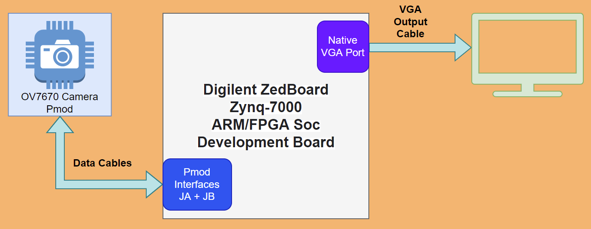
General Overview of Project
3
Basic Block Diagram
The main aim of my project is to pipe the output of the peripheral camera module to any monitor accepting a VGA input.
This project is going to be focusing on a few aspects of this process, namely: the requirements to initiate the peripheral camera module, Programmable Logic modules necessary for implementation, external connections involved alongside their pin mappings and using BRAM’s to act as buffer modules.

Slide 4
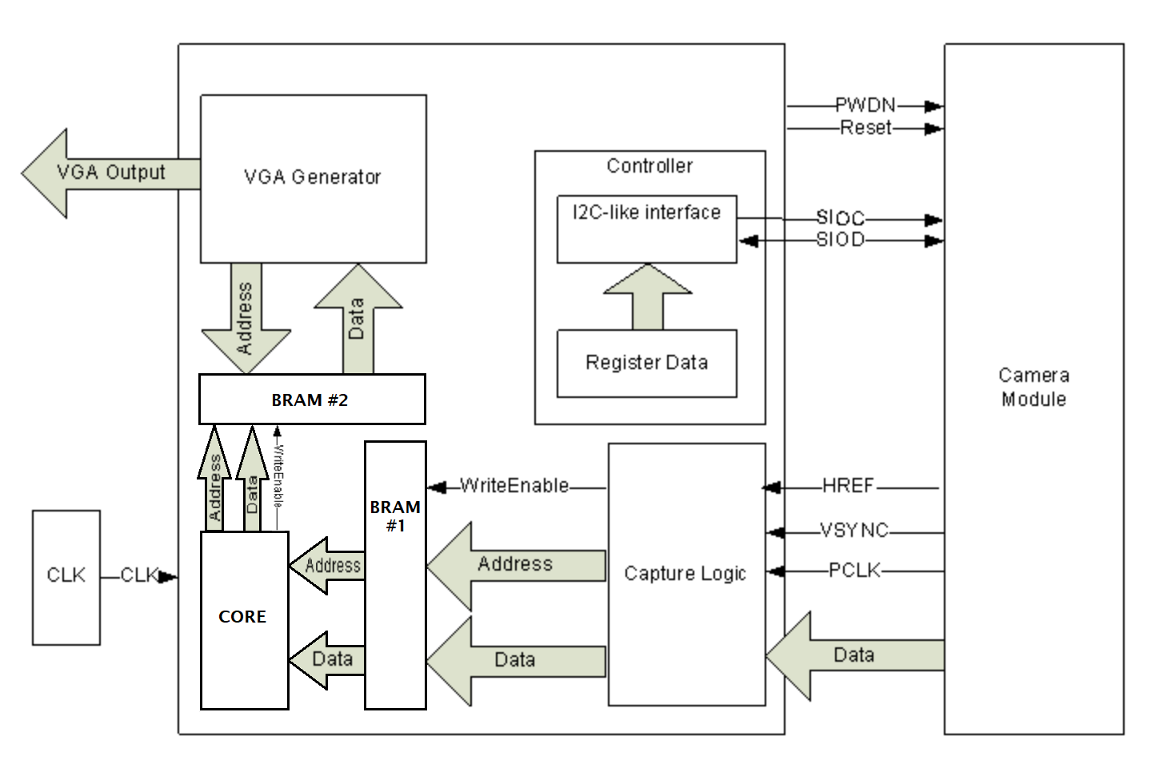
General Overview of Project
4
This Zynq chip is based on the ARM SoC architecture, but in this project, I don’t use the ARM functionality and limit myself to working only with the Programmable Logic part.
The camera module OV7670 is set to a resolution of 640x480, such a modest resolution is chosen because the Pmod itself is limited to a max resolution of 640x480.
The resulting video is sent out via the VGA cable at a speed of 25 frames per second, and output can be viewed on any monitor screen.
Basic Schematic for Implementation

Slide 5
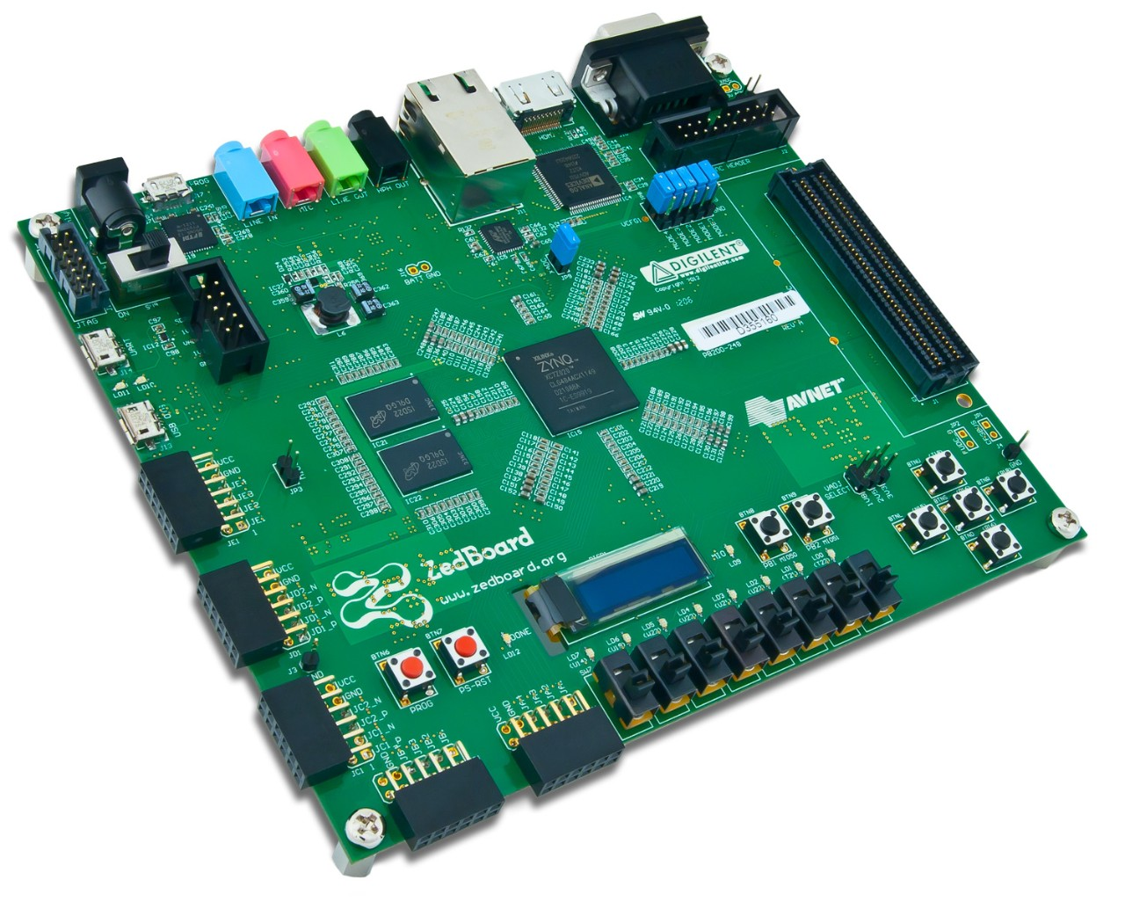
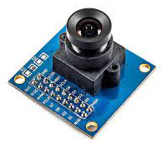
Tools Required
5
Micro USB cable: This will be connected to the PROG connector of the Zedboard and is needed to load the fabric logic as we’ll move forward.
Zedboard: Development board procured via the department of Electrical Engineering at CSUN. It is a convenient, well documented board that runs an ARM processor for managing the PS side.
OV7670 pmod: This is the Camera module utilized for the project
Connecting cables: Simple cables to connect the OV7670 camera unit
to the board interfaces of JA and JB.
VGA cable: This will carry the output to Its destination.
Monitor: This will be needed to view the final output.
Vivado IDE: Needs no introduction by now.
Digilent Zedboard Zynq-7000
OV7670 Camera

Slide 6
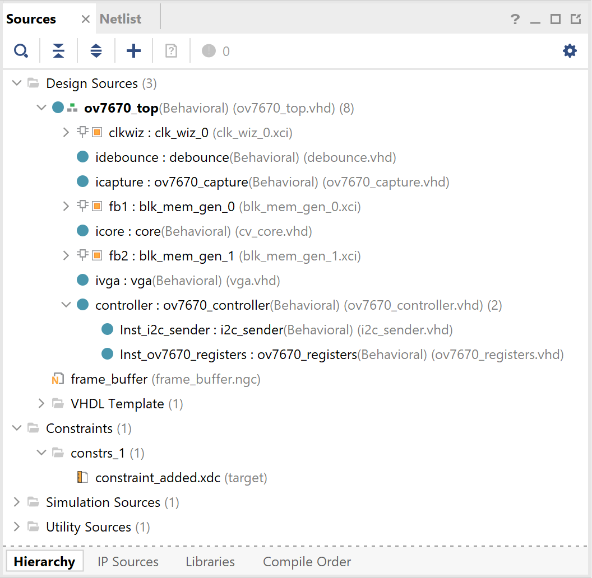
VHDL & IP files hierarchy
6
The image on the left depicts the hierarchy of the design files involved in my project.
Things to note here:
IPs used in my project: Clocking Wizard, BRAM.
Controller module consists of two internal modules: i2c_sender and ov7670_registers.
Source files hierarchy

Slide 7
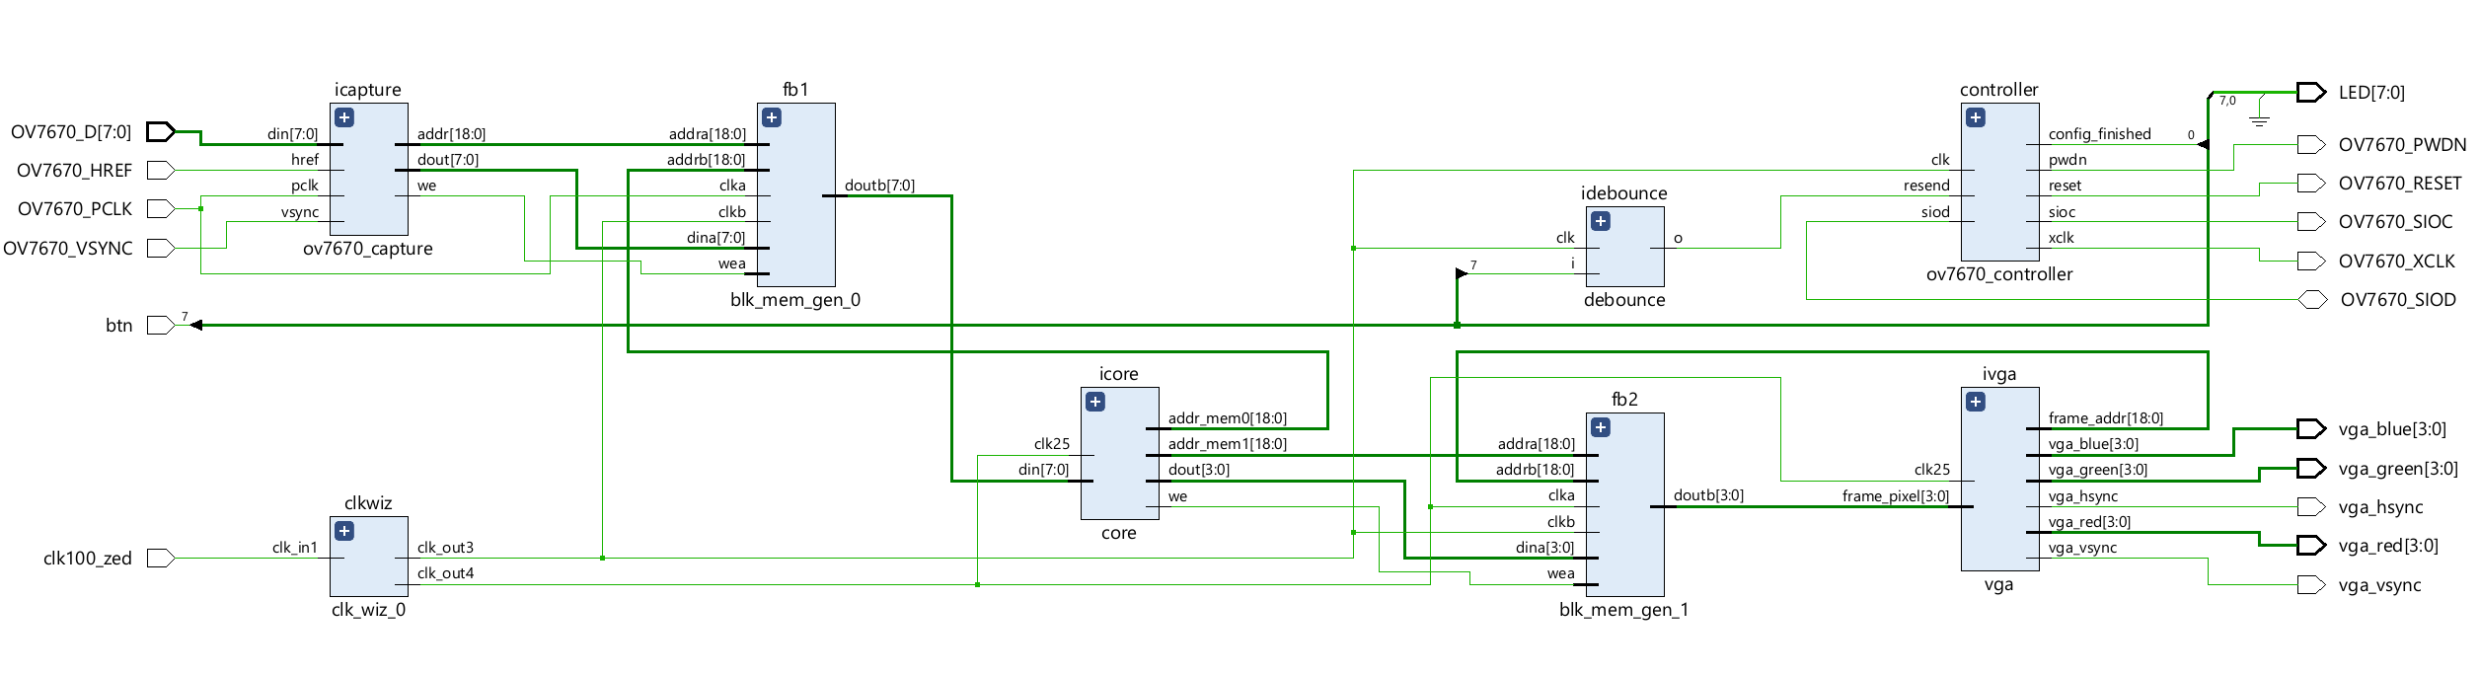
Top-Level RTL Schematic
7
RTL Schematic for Implementation

Slide 8
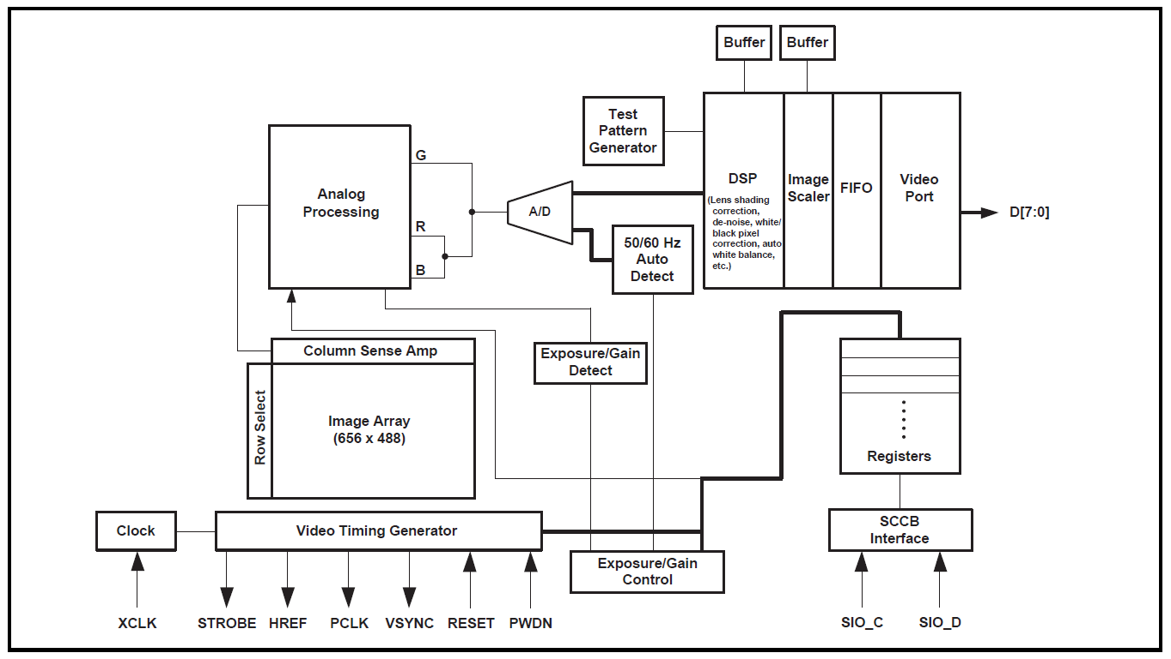
Deeper Look into OV7670 Pmod
8
My guide for this project was the reference manual for the Pmod: OV7670/OV7171 CMOS VGA (640x480) CameraChip Implementation Guide [2].
Things to note in the block diagram:
Video Timing Generator: takes an input XCLK – which comes from my clk_wiz_3 (50Mhz) and generates PCLK among others as outputs. PCLK will inform our system of the rate at which data will arrive from the Pmod and can be scaled via register settings.
Registers: The set of registers needs to be initialized and be set according to a preset standard depending on what mode of output you want to implement.
Functional Block Diagram: OV7670 Camera

Slide 9
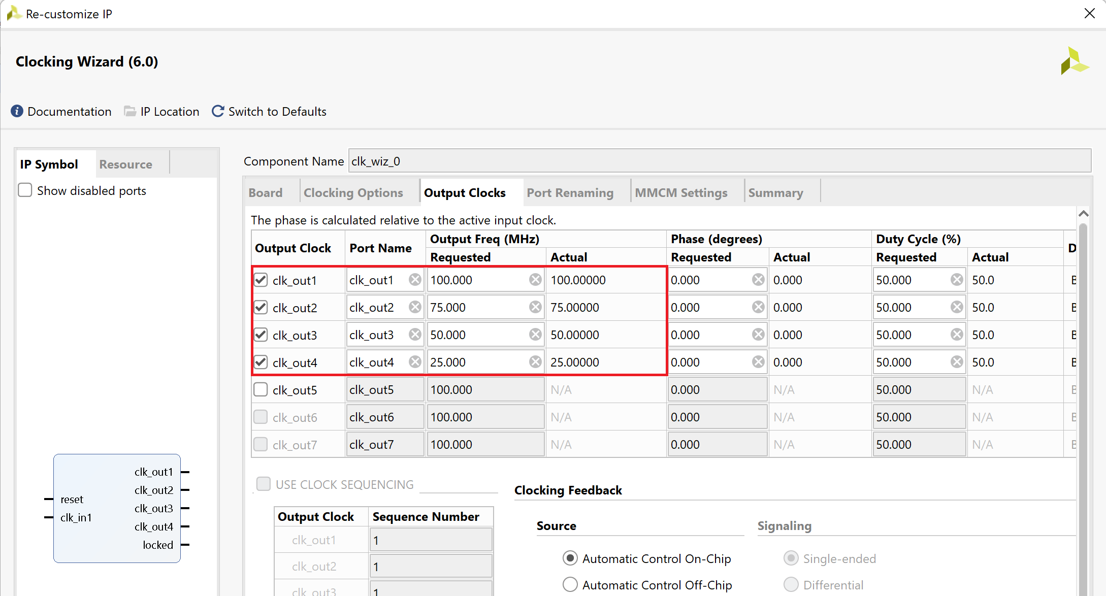
Clocking Module
9
For providing a clock to my synchronous components I utilized the IP: Clocking Wizard.
But this IP does not generate a clock signal from nothing, it still requires an input clock which it will then modify into our requirements.
Possible clock sources on Zedboard: ZYNQ7 Processing System IP block or An on-board 100 MHz oscillator (IC17, Fox 767-100-136) which supplies the PL subsystem clock input on bank 13, pin Y9
We use two clocking frequencies in our design 25 Mhz and 50 Mhz.
Output Settings for Clocking Wizard IP

Slide 10
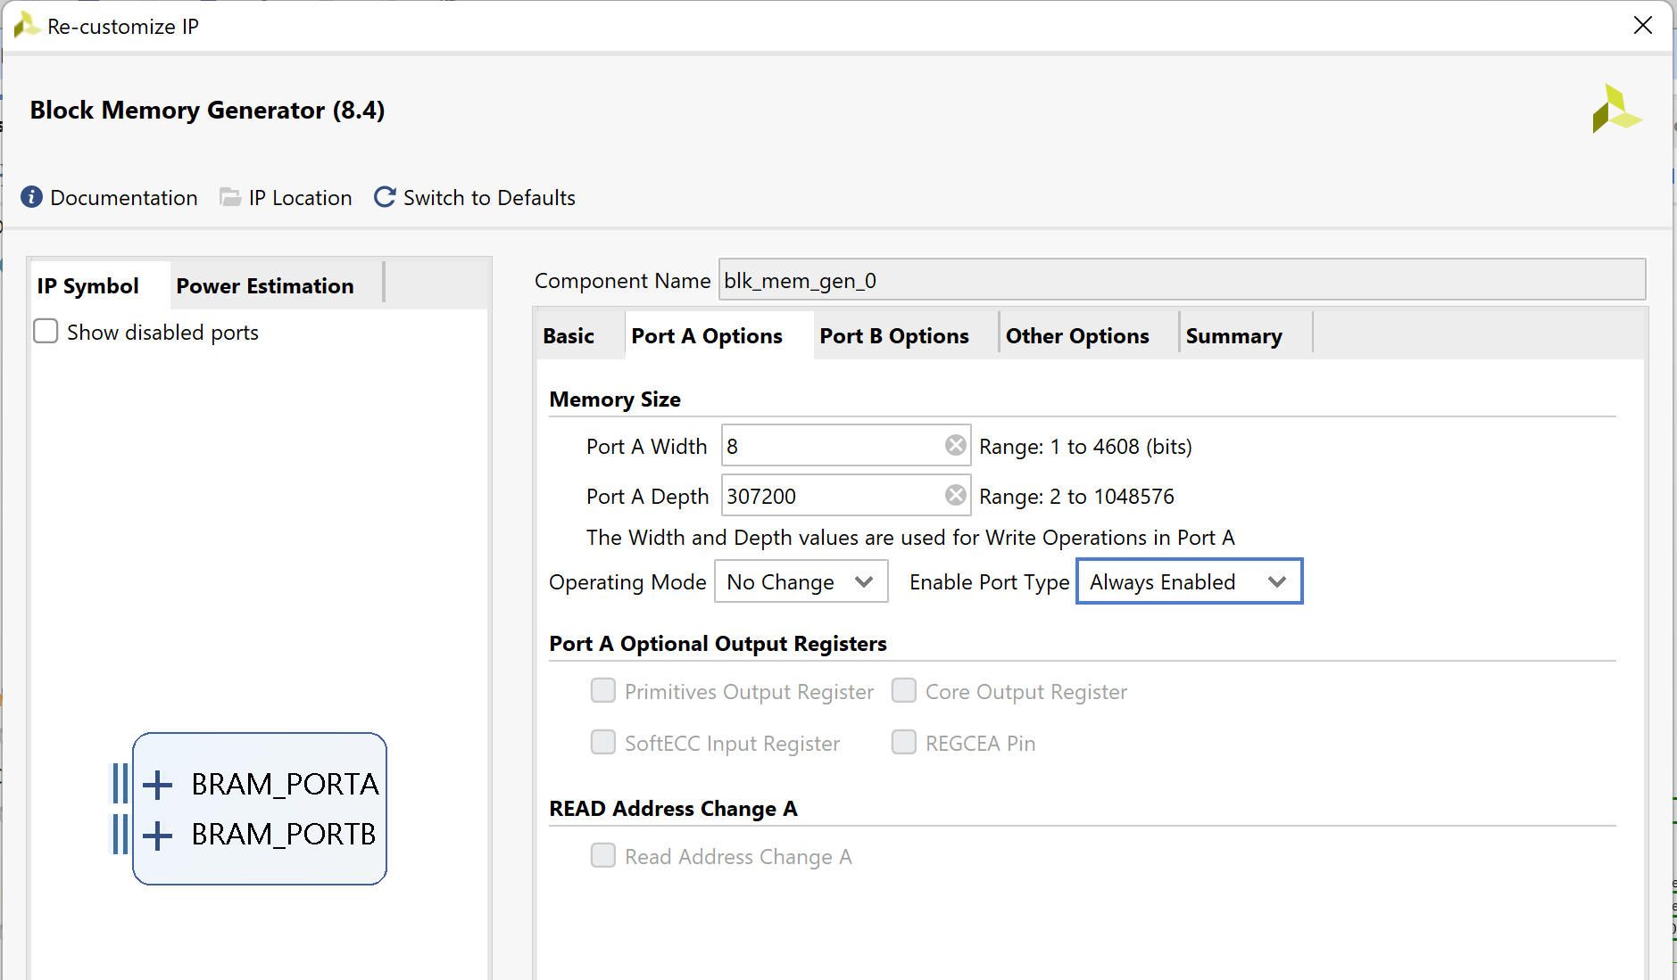
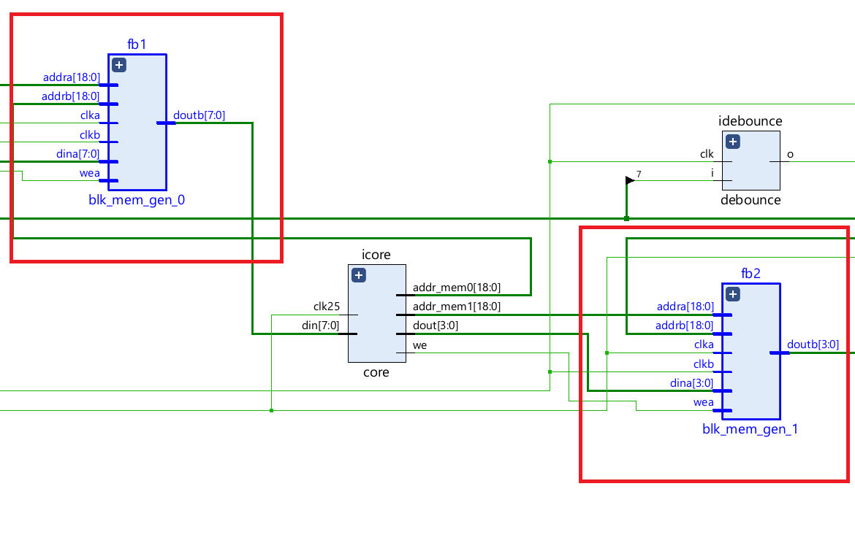
Block RAM Modules
10
Used as frame buffers in my design to store image pixel data.
BRAM 1 is 8 bits deep while BRAM 2 is 4 bits deep.
Port Depth is dictated by the target resolution.
Port Settings for BRAM IP
Position of BRAM blocks in RTL Schematic

Slide 11
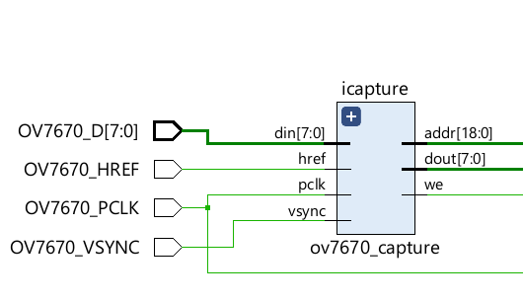
Data Capture Module
11
Captures the pixels coming from the OV7670 camera and stores them in our Block RAM.
Our Pmod is operating in YUV mode (Method of Initializing Pmod in this mode discussed later).
This module has two main states of operation:
In this state it passes the data coming from the Pmod to the BRAM while assigning that data a unique address at which it will be stores inside the RAM module.
In this state it disables the BRAM and increments the address channel to ensure that the next stream of inbound data will be assigned the proper address.
Clock frequency for this module is dependent on what the Pmod provides via OV7670_PCLK, this affects our design in two major ways:
The BRAM module storing the frame pixel data will have to be clocked at the same speed to avoid data loss.
This clk frequency will decide the upper fps limit of our final output, max fps possible will be half of this frequency. If we drive our output any faster, we’ll face data loss.
Schematic for Capture Logic Block

Slide 12
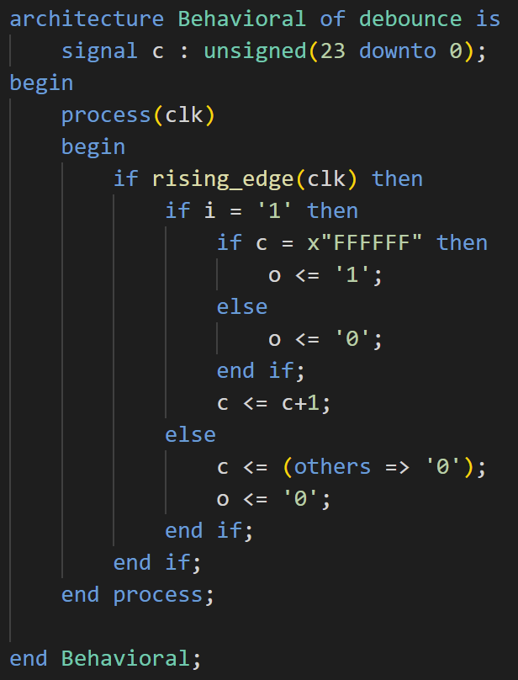
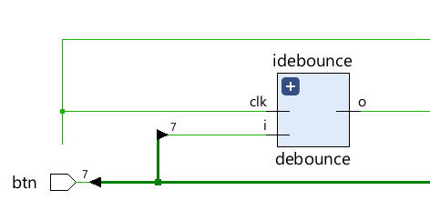
Debounce (Restart) Module
12
This module has one simple function: program the chosen push button to generate one output per push irrespective of any clocking frequency, which can be used as a Restart for our system.
The btn is also connected to one of the on-board LED’s so we can confirm functionality.
Schematic for Debounce Block
The image on the right depicts how this behavior is achieved via VHDL.
VHDL – Debounce Module

Slide 13
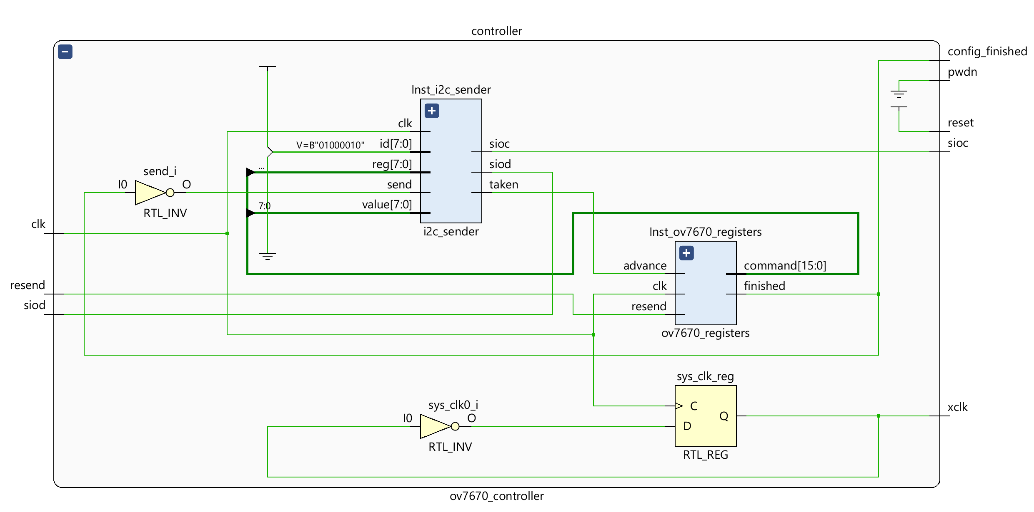
Pmod Controller Module
13
This module is the main controller for the OV7670 Camera Pmod.
The basic purpose of this module is to provide the OV7670 Camera Chip with the necessary initialization settings so it may function as we intended.
Normally the initialization stage is something that we’re used to doing at the software stage in Vitis using C: turning ON the device, resetting it, calibrating it to specifics. But I chose to do this via VHDL because this Pmod uses SCCB Communication Protocol to talk to the outside world.
Although SCCB is similar to i²C it is not the same, which means I wouldn’t be able to utilize any function libraries pertaining to i²C communications.
Register data and addresses are concatenated together along with other preset elements and sent in a serial manner.
Internal RTL Schematic for Controller Module

Slide 14
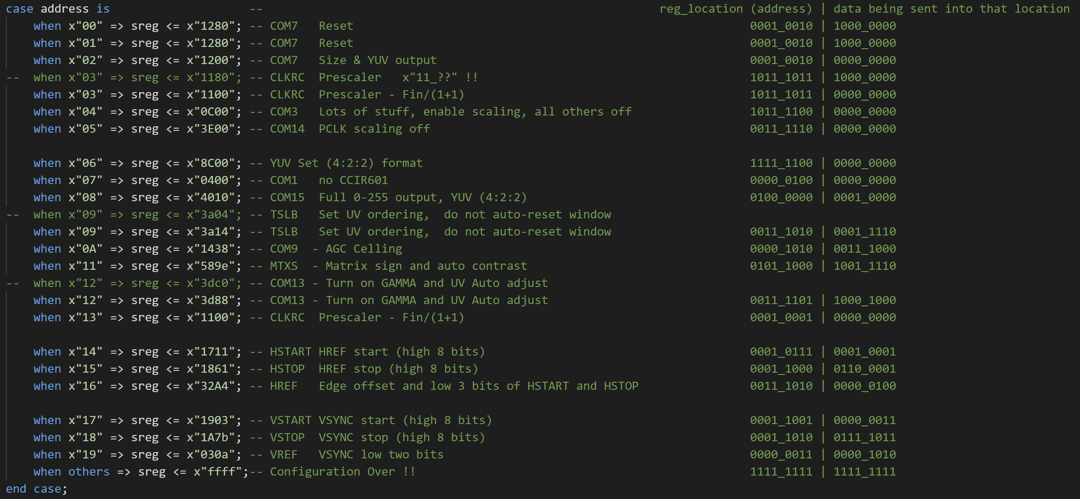
Controller: Registers Module
14
The main function of this module is to provide the Pmod with the required data in order to initialize it in YUV mode.
All settings required for initialization can be found in the Pmod reference manual.
Register Settings for Initialization

Slide 15

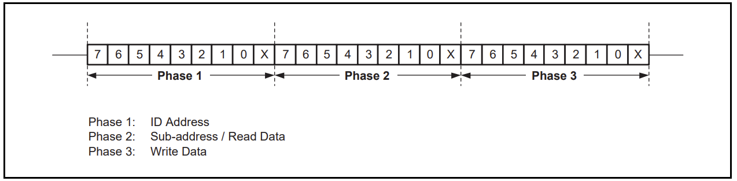
Controller: SCCB Communication Module
15
2-wire SCCB Functional Block Diagram
This is a modified 2-wire version of the original 3-wire SCCB protocol, 1:1 communication protocol [3-4].
SIO_C: this is a single-directional, active-low, control signal that must be driven by a master device. It indicates each transmitted bit. The master must drive SIO_C at logical 1 when the bus is idle. A data transmission starts when SIO_C is driven at logical 0 after the start of transmission.
SIO_D: this is a bi-directional data signal that can be driven by either master or slave devices. It remains floating, or tri-state when the bus is idle. Maintenance of the signal is the responsibility of both the master and slave devices in order to avoid propagating an unknown bus state.
Register Settings for Initialization

Slide 16
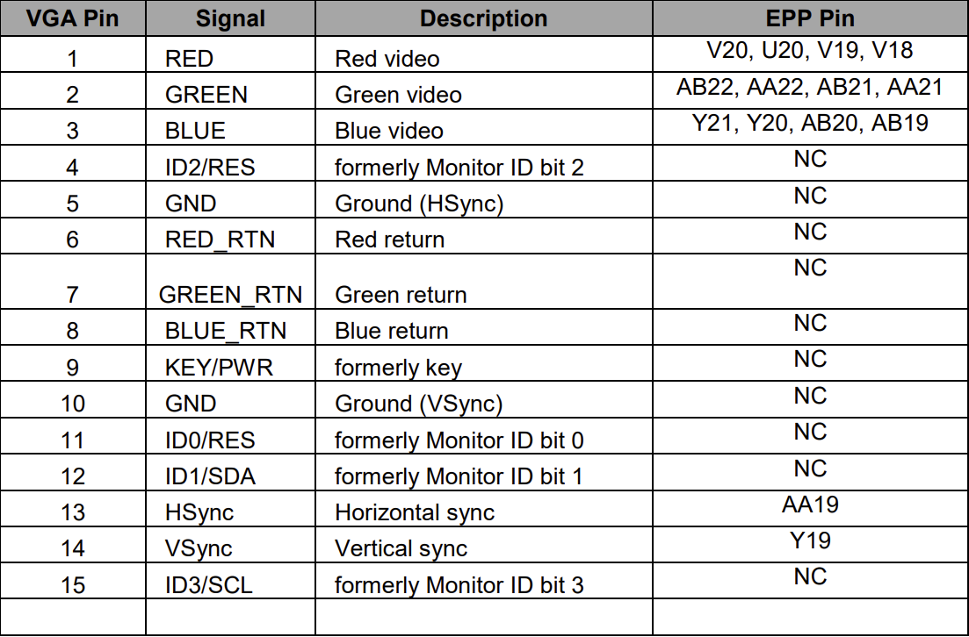
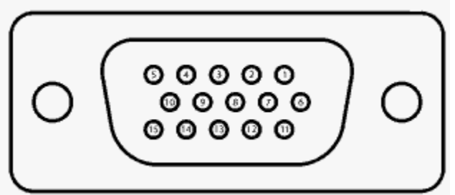
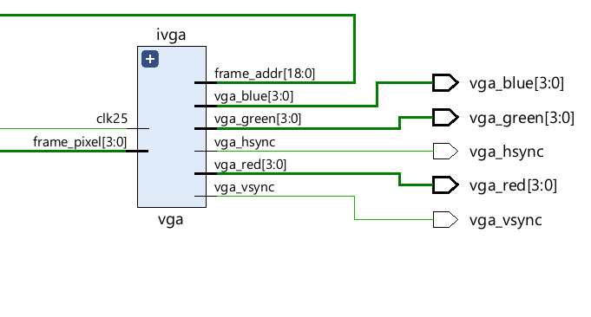
VGA Output Module
Main purpose of this module is to generate analog 620x480 VGA Output.
This module is simply scanning the pixel data from the BRAM modules and placing the same data onto vga red, blue and green output cables.
The reason for placing the same data onto all three red, blue and green channels is because after coming out of the core module in my design my frame_pixel data is already in grayscale format.
16
VGA Port
VGA Connections on the Zedboard
Schematic for VGA Module

Slide 17
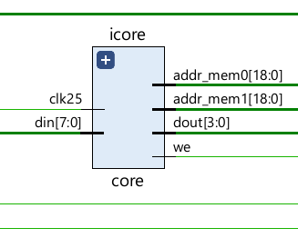
Core Module
17
The basic purpose of this module is to convert color data to grayscale.
The need for this module arose because initially I was setting the OV7670 Camera to initialize in an RGB format and realizing grayscale from RGB is complicated.
To convert Grayscale from RGB, the formulae is: Grayscale = 0.299R + 0.587G + 0.114B
Is there a better way … 🤔
Schematic for Core Module

Slide 18
Core Module
18
The basic purpose of this module is to convert color data to grayscale.
The need for this module arose because initially I was setting the OV7670 Camera to initialize in an RGB format and realizing grayscale from RGB is complicated.
To convert Grayscale from RGB, the formulae is: Grayscale = 0.299R + 0.587G + 0.114B
Is there a better way … 🤔
YUV format !!!
Y(Luminance) U(Blue-luminance) V(Red-luminance)
To convert Grayscale from YUV, the formulae is: Grayscale = Y
According to our initialization settings we set YUV in a 4:2:2 format, meaning bits 7-4 are assigned to Y, 3-2 are assigned U and 1-0 are assigned V.
This works perfectly for us as we needed a 4-bit format for the VGA output anyways.
Now we can just connect our output to the 4 MSB bits from the incoming data and we’ll have grayscale frame pixel data.
Schematic for Core Module

Slide 19
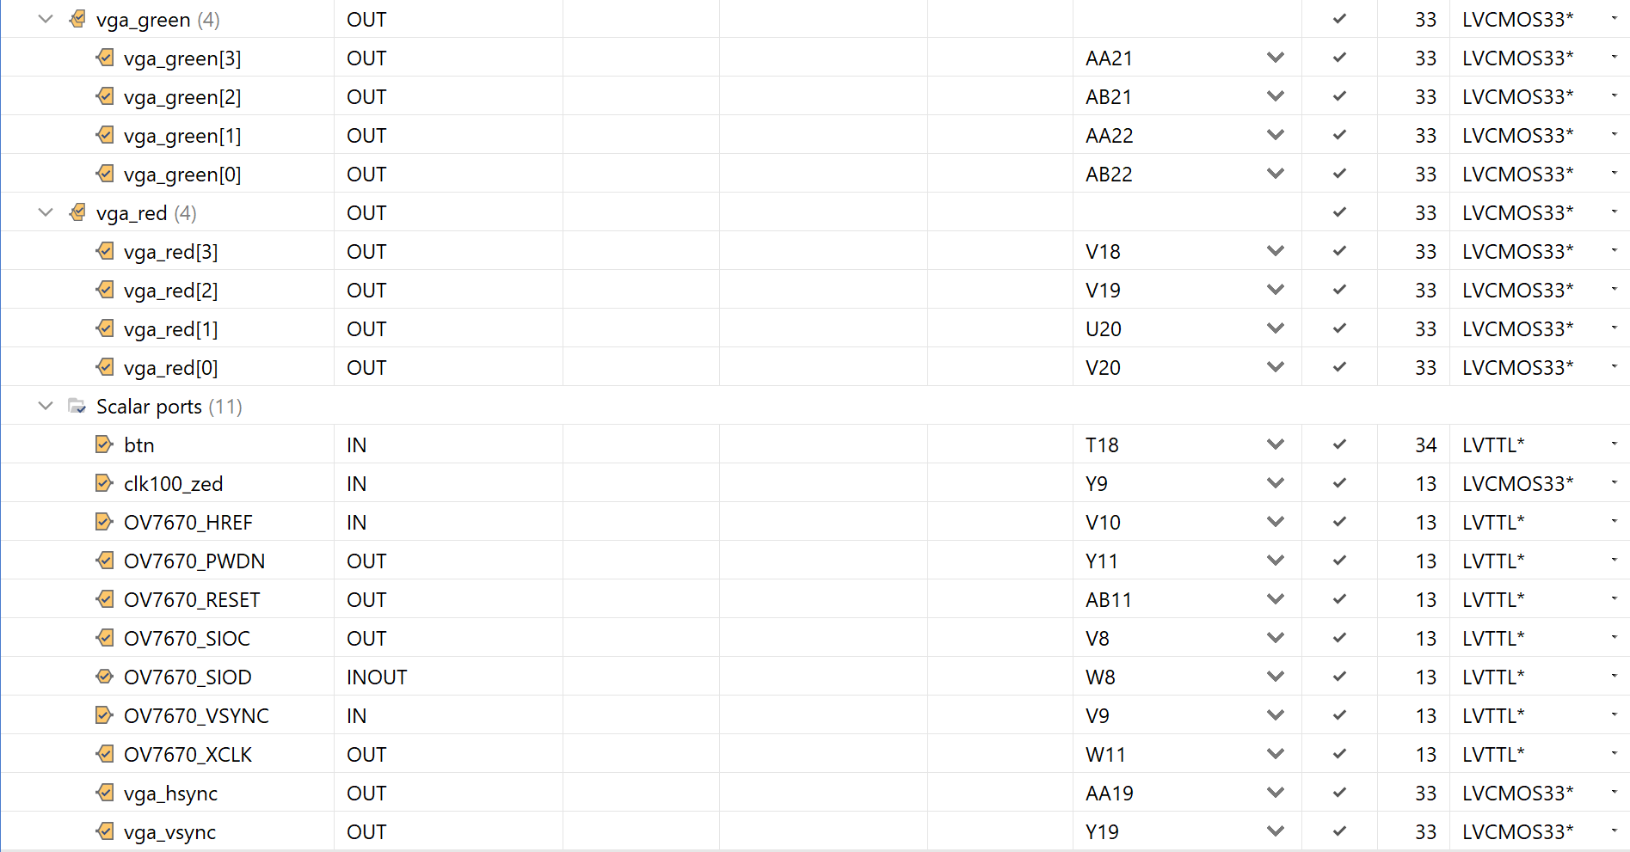
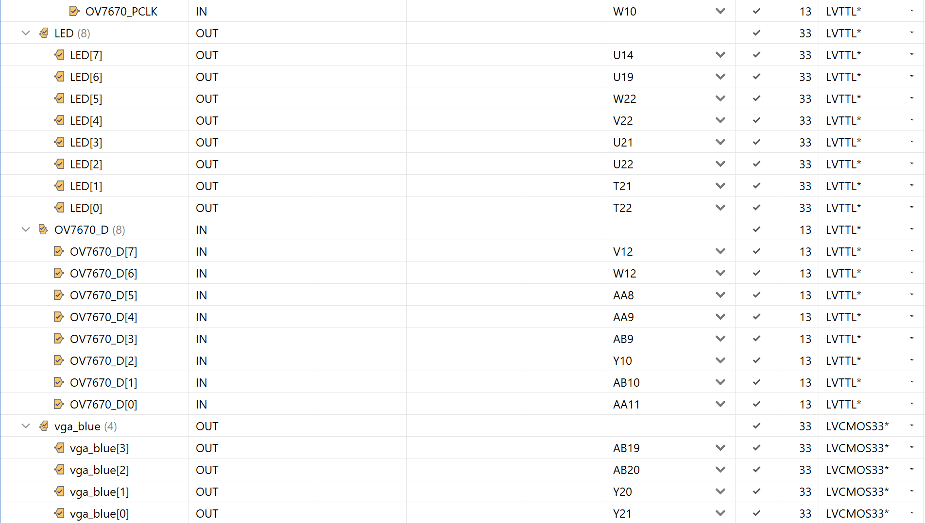
Pin Mappings
19
The images below depict all pin mappings involved in my design.
Mostly external connections involving Pmod and VGA.
Few internal connections involving on-board LEDs for indication purposes.
Pin mappings for all external connections involved in design

Slide 20
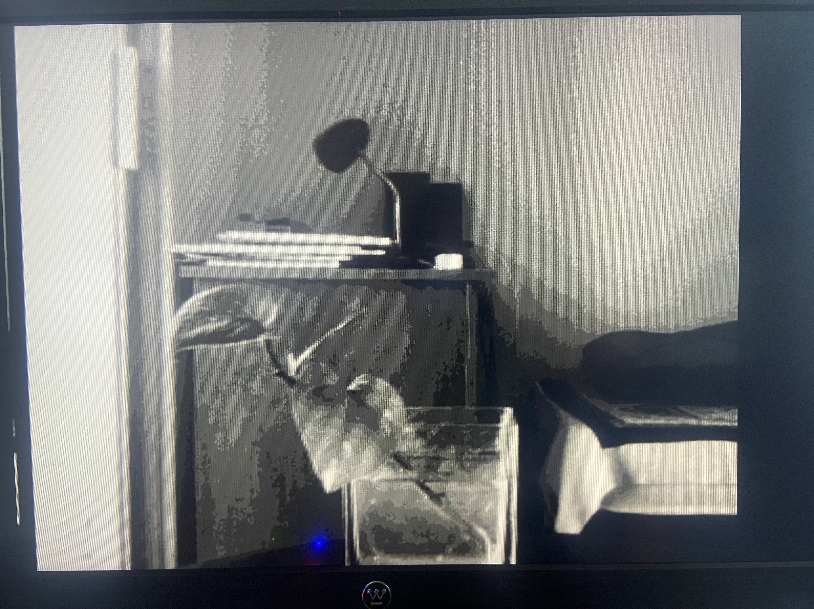
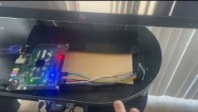
Video Demo
20
Fps check: https://youtu.be/34jz1RZQFFE
Sample Output Image

Slide 21
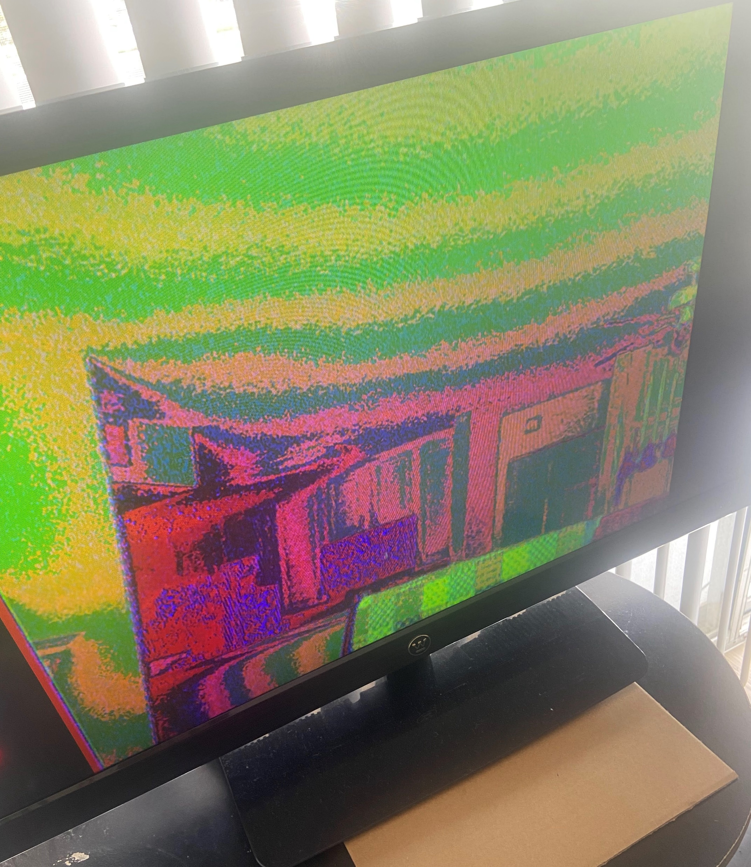
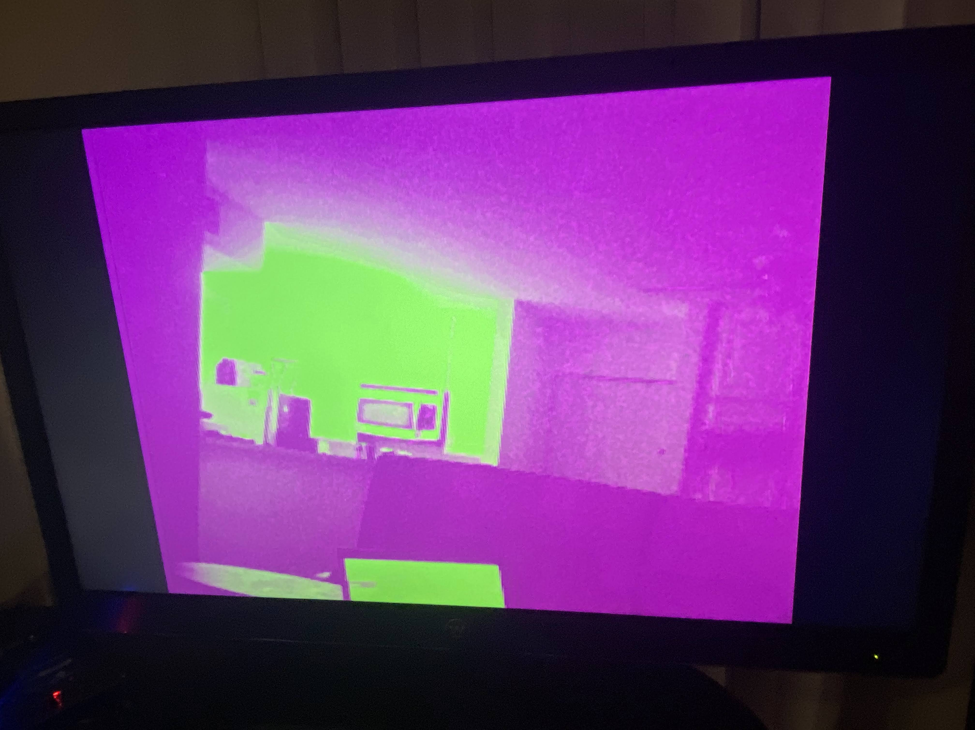
Limitations & Future Work
21
Limitations:
Project is in grayscale because I couldn’t crack the mysteries behind color video processing. Images on the right-hand side show my failed attempts.
Future Work:
Fine-tuning and trying to perfect a color implementation.
The core module is placed in an ideal place where we can think about adding certain logic for computer vision algorithm and we can easily add additional RAM modules to help in this data processing.
Failed attempt 1
Failed attempt 2

Slide 22
References
22
[1] https://www.xilinx.com/content/xilinx/en/support/university/boards-portfolio/xup-boards/DigilentZedBoard/_jcr_content/root/parsys/xilinxcolumns_f62b/childParsys-0/xilinxbuybox_943e/thumbnail/image.img.jpg/1381869368208.jpg
[2]http://www.haoyuelectronics.com/Attachment/OV7670%20+%20AL422B%28FIFO%29%20Camera%20Module%28V2.0%29/OV7670%20Implementation%20Guide%20%28V1.0%29.pdf
[3] https://www.waveshare.com/w/upload/1/14/OmniVision_Technologies_Seril_Camera_Control_Bus%28SCCB%29_Specification.pdf
[4] http://www4.cs.umanitoba.ca/~jacky/Teaching/Courses/74.795-LocalVision/ReadingList/ov-sccb.pdf

Slide 23
Q&A

